Slide 1
PREDICTING CUSTOMER BUYING BEHAVIOUR
Build a predictive model to understand factors that influence buying behaviour

Slide 2
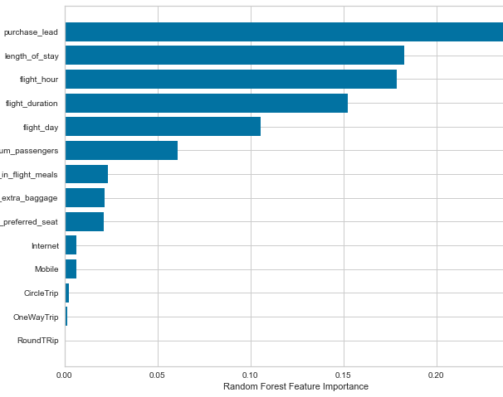
Result
From our feature importance from model that influencing factors for customers to completing their bookings are purchase_lead (namely the time gap between the order time and the flight) and length_of_stay (namely how long the customer will occupy the destination)

